Slide 2




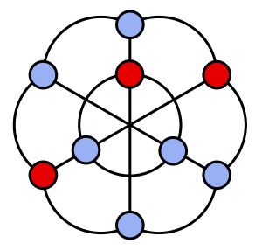
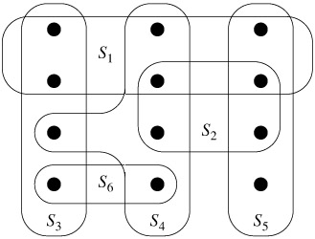
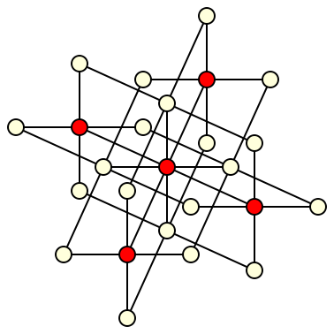



Slide 3

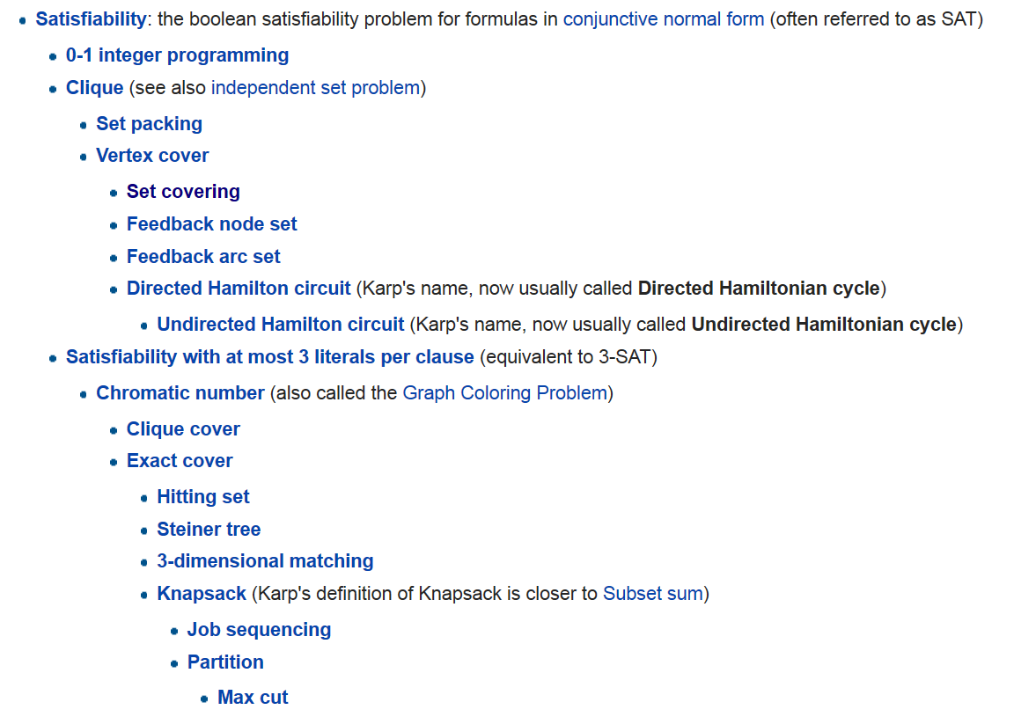



Slide 4

Notes:
In this talk, restricted to these two problems.

Slide 5




Slide 6







Slide 7



Slide 9





Slide 10



Slide 11














Slide 12


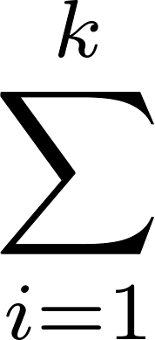



Slide 14


Slide 15


Slide 17
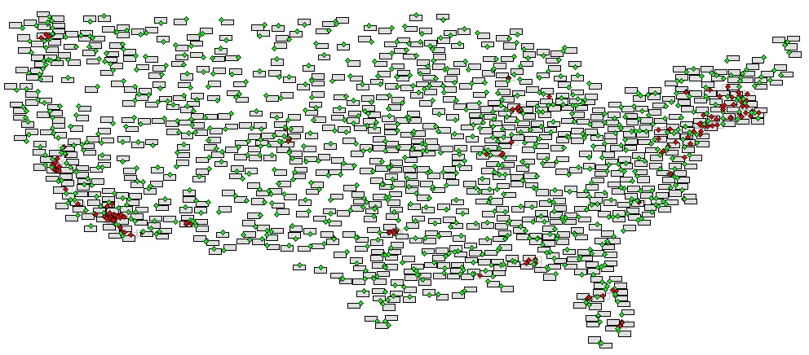
Notes:
What does gromov etc get for 3D : barany constant?
Do we improve that result in 3D as well?

Slide 19


Slide 20






Slide 22
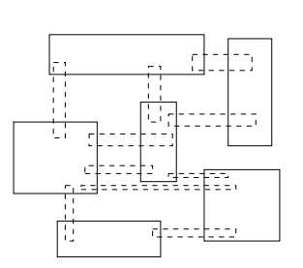
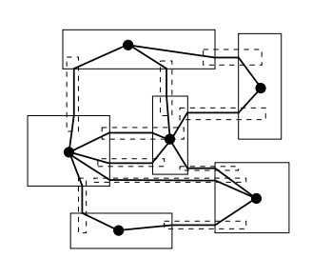


Slide 23


Notes:
Bronniman-Goodrich

Slide 24


Slide 25



Slide 27


Slide 28



Slide 29

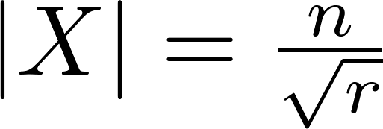
















Slide 31


Slide 32


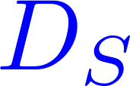

Slide 33


Slide 34



Slide 37


